Slide 1

Urška Sršen and Sando Mur founded Bellabeat, a high-tech company that manufactures health-focused smart products. Sršen used her background as an artist to develop beautifully designed technology that informs and inspires women around the world. Collecting data on activity, sleep, stress, and reproductive health has allowed Bellabeat to empower women with knowledge about their own health and habits. Since it was founded in 2013, Bellabeat has grown rapidly and quickly positioned itself as a tech-driven wellness company for women.
HOW CAN A WELLNESS TECHNOLOGY COMPANY PLAY IT SMART?
Prepared by: Ahmad El-Sadek Mohamed
Last Update: November 13, 2022

Slide 2
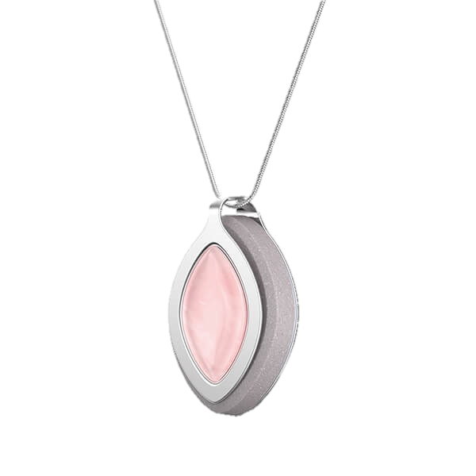
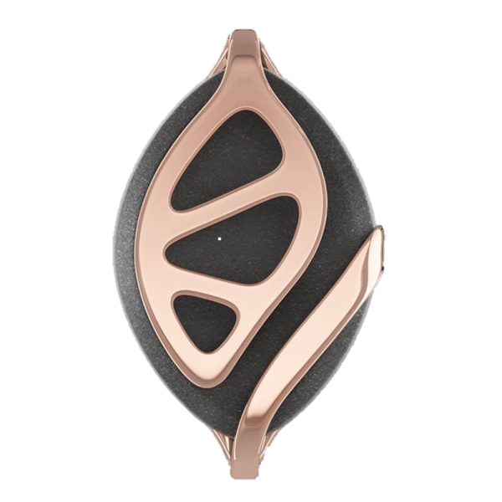
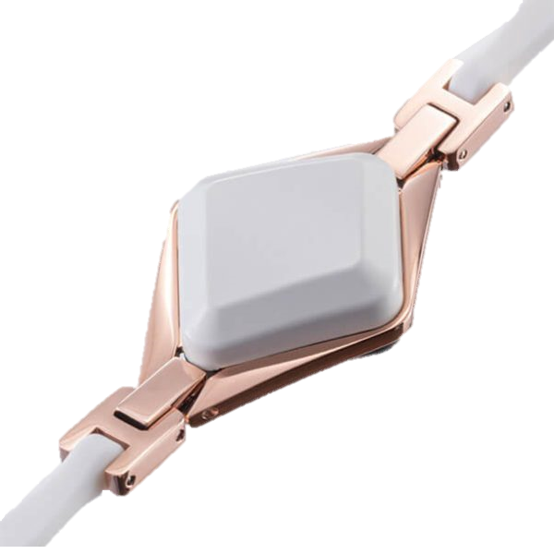
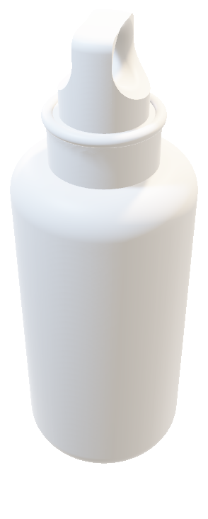
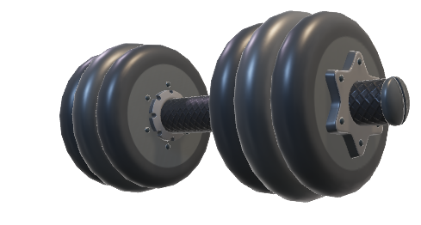
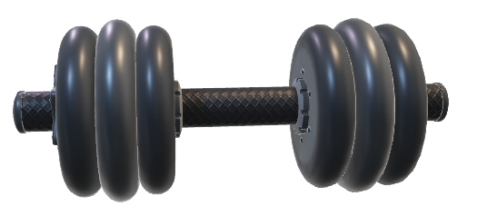
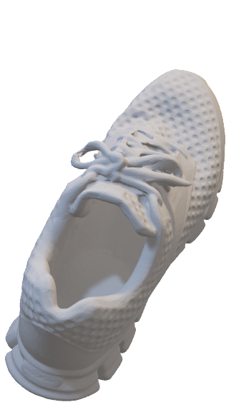
HOW CAN A WELLNESS TECHNOLOGY COMPANY PLAY IT SMART?
Urška Sršen and Sando Mur founded Bellabeat, a high-tech company that manufactures health-focused smart products. Sršen used her background as an artist to develop beautifully designed technology that informs and inspires women around the world.
Collecting data on activity, sleep, stress, and reproductive health has allowed Bellabeat to empower women with knowledge about their own health and habits. Since it was founded in 2013, Bellabeat has grown rapidly and quickly positioned itself as a tech-driven wellness company for women.
Prepared by: Ahmad El-Sadek Mohamed
Last Update: March 31st, 2022

Slide 3

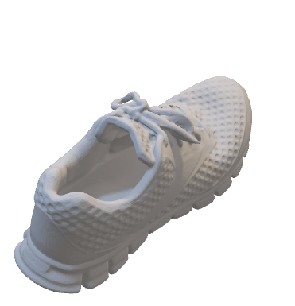
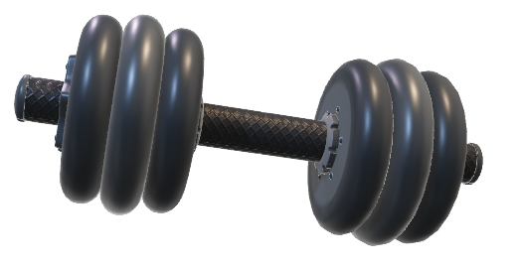
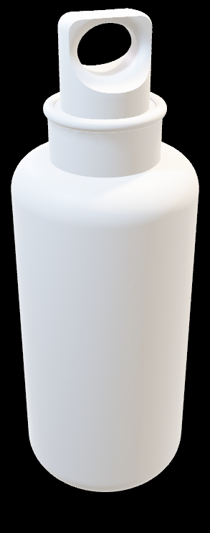
GOALS OF THIS PRESENTATION
KEY TAKEAWAYS
GUIDING HYPOTHESIS
RECOMMENDATIONS AND NEXT STEPS

Slide 4
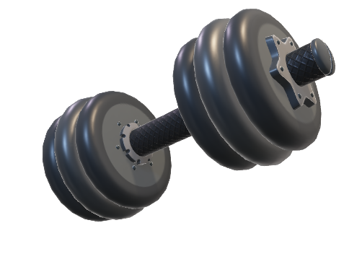
GOALS OF THIS PRESENTATION
Urška Sršen believes that analyzing smart device fitness data could help unlock new growth opportunities for the company. I've been asked to focus on one of Bellabeat’s products and analyze smart device data to gain insight into how consumers are using their smart devices. In conclusion, the main business task here is:
How are consumers using their smart devices?
GOALS OF THIS PRESENTATION

Slide 5
In order to achieve the business task, I’ll have to answer the following questions:
What are some trends in smart device usage?
How could these trends apply to Bellabeat customers?
How could these trends help influence Bellabeat marketing strategy?
GOALS OF THIS PRESENTATION

Slide 6

GUIDING HYPOTHESIS
I'll be using a public dataset that explores smart device users’ daily habits: FitBit Fitness Tracker Data (CC0: Public Domain, dataset made available through Mobius.
These Kaggle datasets contain personal fitness tracker data from 33 fitbit users. These users consented to the submission of their personal tracker data, including minute-level output for physical activity, heart rate, and sleep monitoring. It includes information about daily activities that can be used to explore users’ habits.
I’ll be using several metrics that will be introduced along the presentation.

Slide 7
I’ll be using several metrics in this presentation, defined as the following:
ID: this represent the ID number assigned to the eligible Fitbit users consented to the submission of their personal tracker data.
Activity Day: this represents the weekday in which the records were registered.
Total Distance: total distance recorded in kilometres.
Distance Level: level which a certain distance belongs to (I’ve created four levels).
Very Active Distance: recorded distance when user was very active.
Very Active Speed: the average speed of the user when doing very active activities of certain intensity throughout the day.
Lightly Active Speed: the average speed of the user when doing lightly active activities of certain intensity throughout the day.
Moderately Active Distance: recorded distance when user was moderately active.
GUIDING HYPOTHESIS

Slide 8
Light Active Distance: recorded distance when user was lightly active.
Very Active Minutes: recorded minutes when user was very active.
Sedentary Minutes: recorded minutes when user was in sedentary state.
Calories: recorded calories burnt per day.
Calories Level: the level which a certain distance belongs to (I’ve created four levels).
Activity Distance: the summation of different activates distances.
Activity Minutes: the summation of different activates durations in minutes.
Total Minutes Asleep: recorded minutes when user is asleep.
Sleep Level: the level which a certain distance belongs to (I’ve created four levels).
Total Time In Bed With No Sleep (minutes spent in bed with no sleep): total minutes in which the user was in bed but not yet asleep.
Weight (kg): the registered weight of the user in a certain day in kilograms.
GUIDING HYPOTHESIS

Slide 9

KEY TAKEAWAYS
The next slides will introduce the key takeaways from my extended analysis

Slide 10
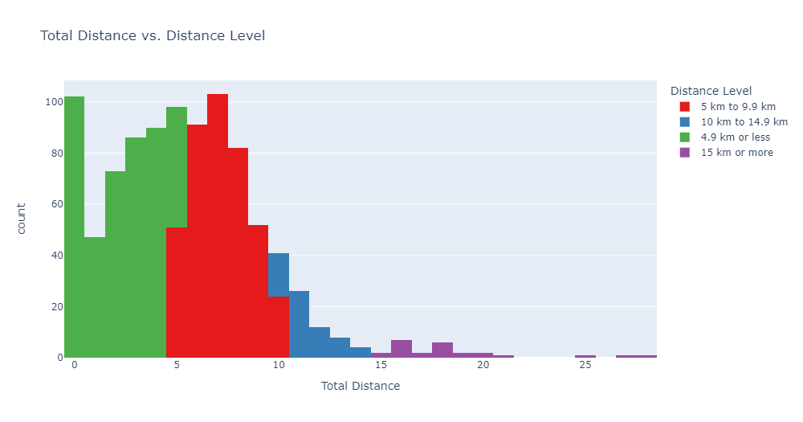
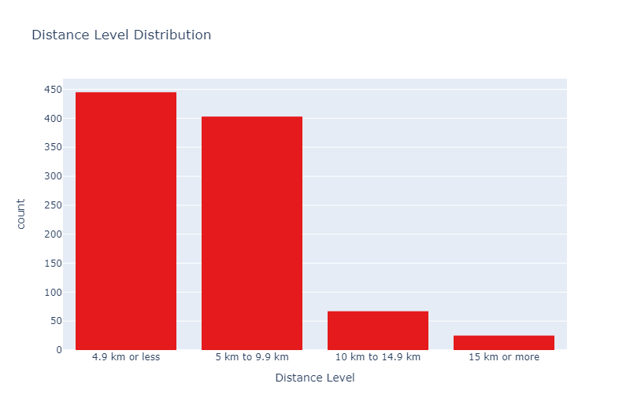
Most of the distances walked were less that 10 km, more than half of them less than 5 km

Slide 11
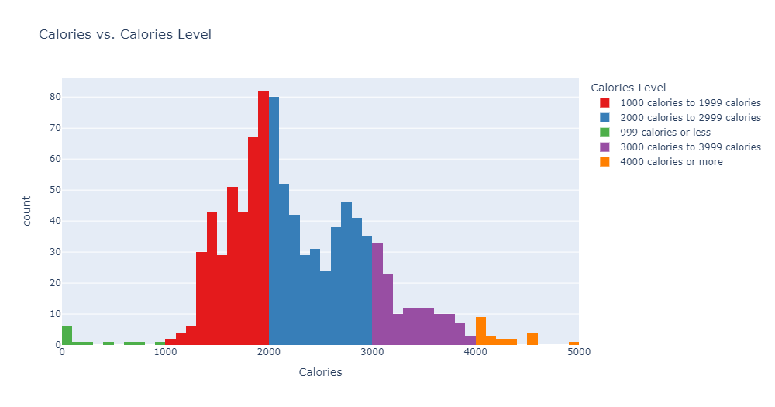
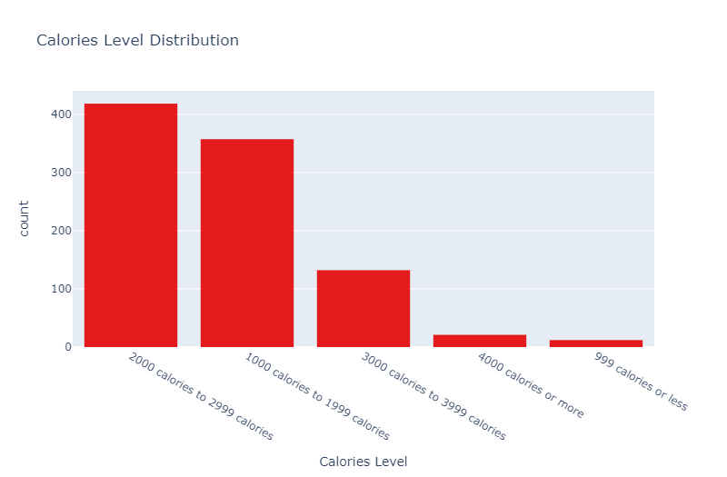
Most of the burnt calories fall between 1000 calories and 3000 calories, more than half of them fall into 2000 to 2999 calories burnt

Slide 12
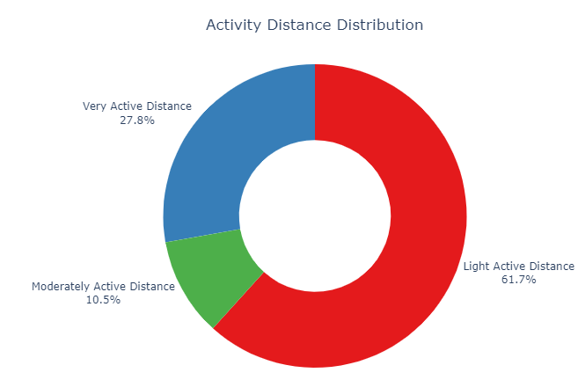
Most of the distances taken daily were from the Light Active Distances (61.7%), followed by Very Active Distances (27.8%), then Moderately Active Distances (10.5%)

Slide 13
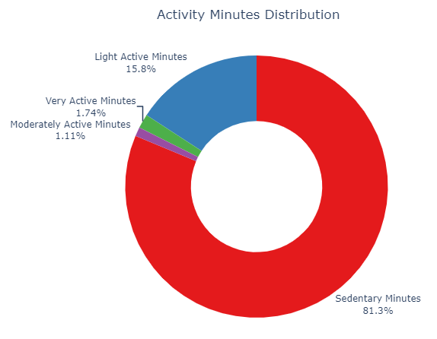
Most of the minutes spent daily were Sedentary Minutes (81.3%), followed by Light Active Minutes (15.8%), then Very Active Minutes (1.74%), and Moderately Active Minutes took the last place (1.11%)

Slide 14
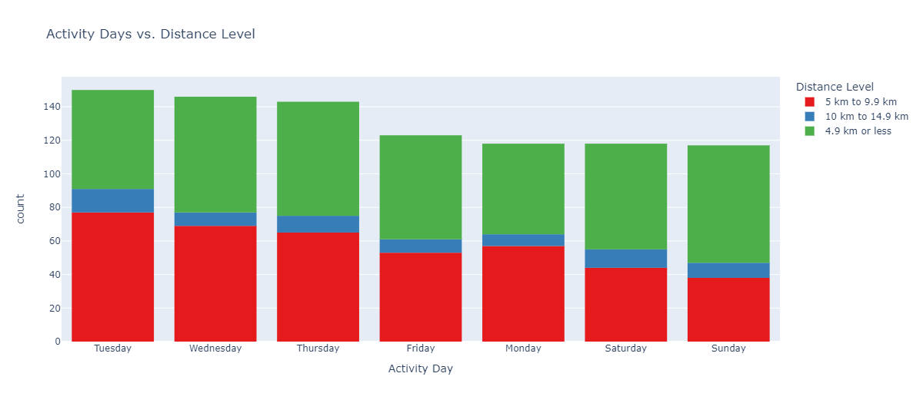
Tuesday, Wednesday, and Thursday seem to be the preferable days for users when they want to walk less than 15 kms a day

Slide 15
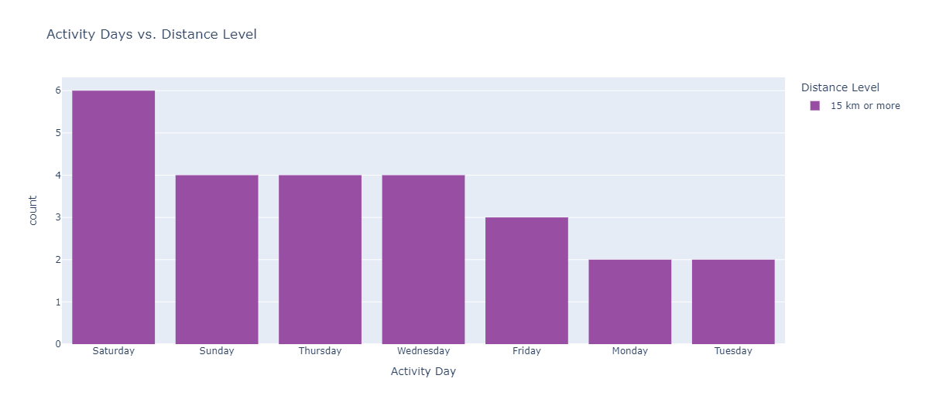
Weekends and midweeks (particularly Saturdays) are preferable to users when they want to walk more than 15 kms a day

Slide 16
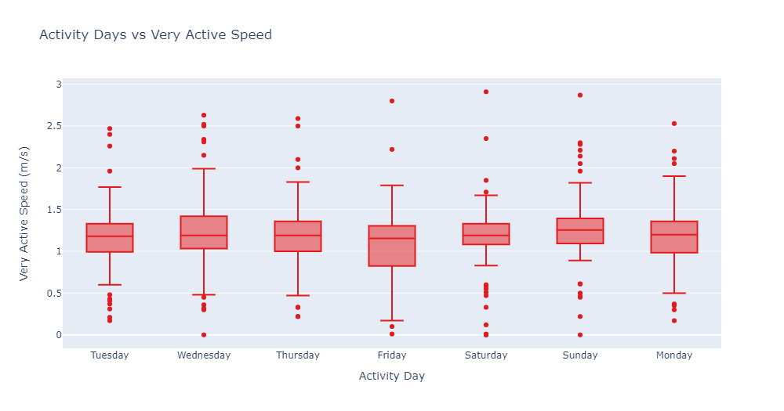
The average user speed when running very active distances decreases on Fridays, and increases sparsely on the weekends

Slide 17
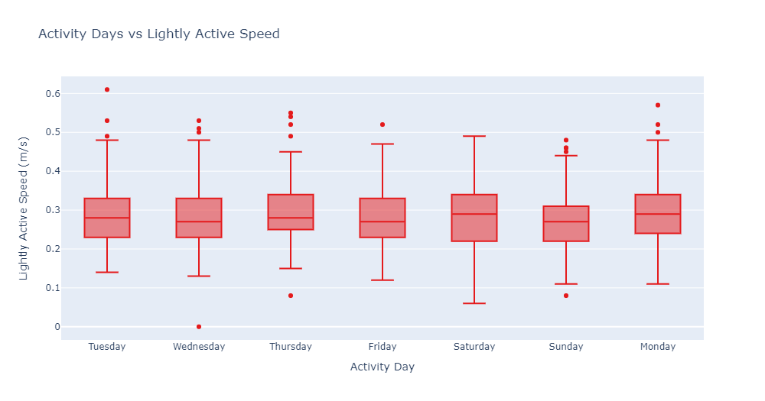
The average user speed when running lightly active distances has been mostly consistent, with only some instances where the speed decreased sparsely on the weekends

Slide 18
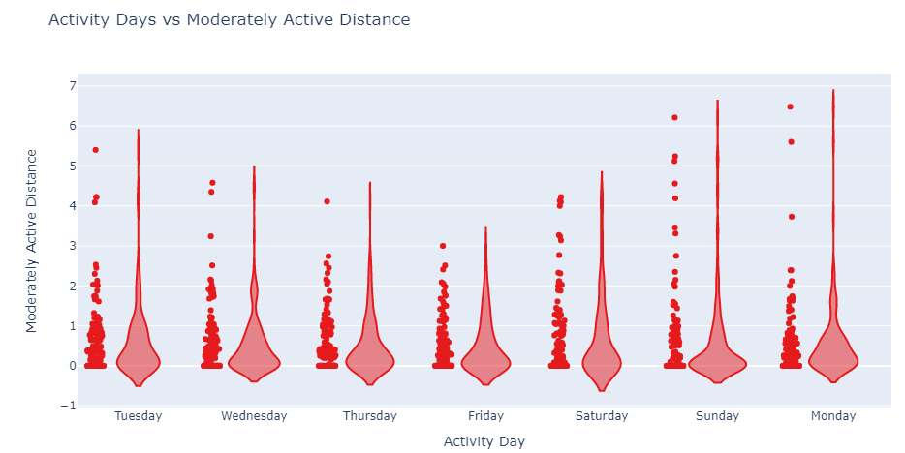
There is a pattern of less moderately active distances walked on Thursdays and Fridays. That might be due to them being the last two days before the weekend, so users might be a little exhausted and need to rest

Slide 19
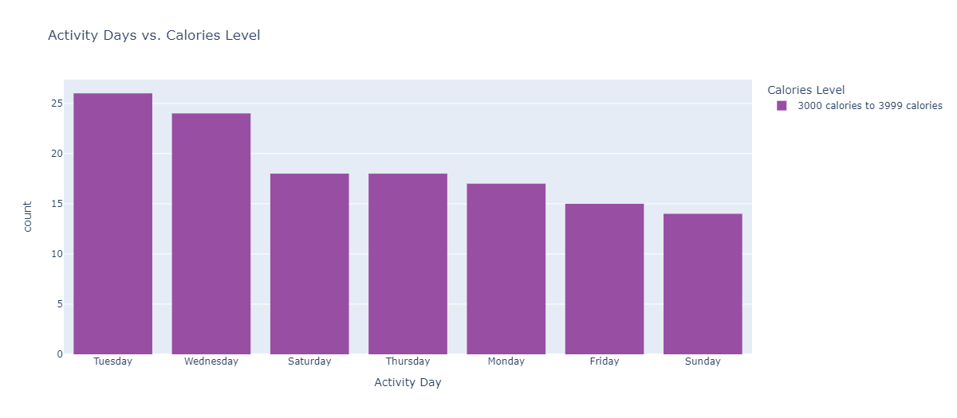
Tuesdays and Wednesdays have the leading spots in the category of 3000 to 3999 burnt in a day

Slide 20
Most of the burnt calories fall between 1000 calories and 3000 calories, more than half of them fall into the 2000 to 2999 category

Slide 21
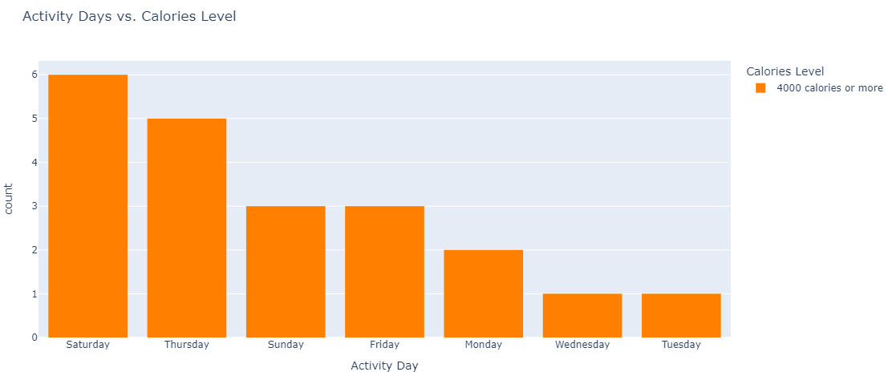
Most of the calories in the category of 4000 or more burnt, while not drastically, are concentrated in Thursdays and Saturdays

Slide 22
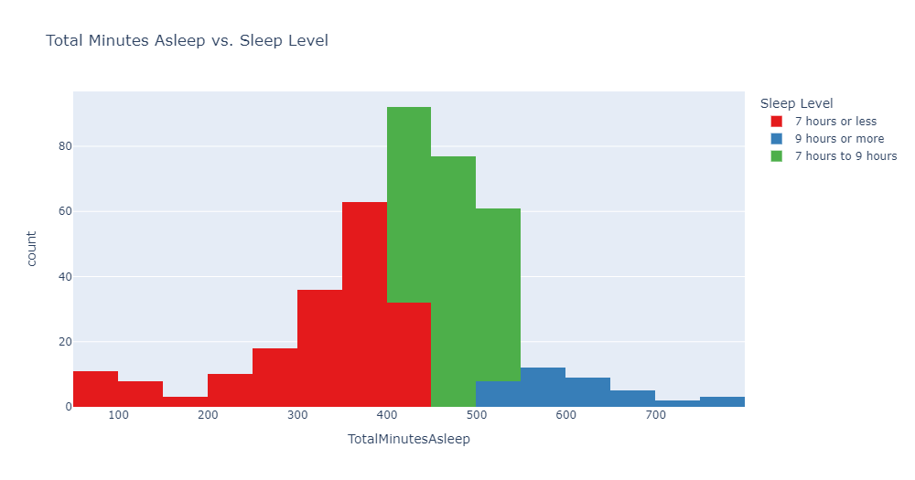
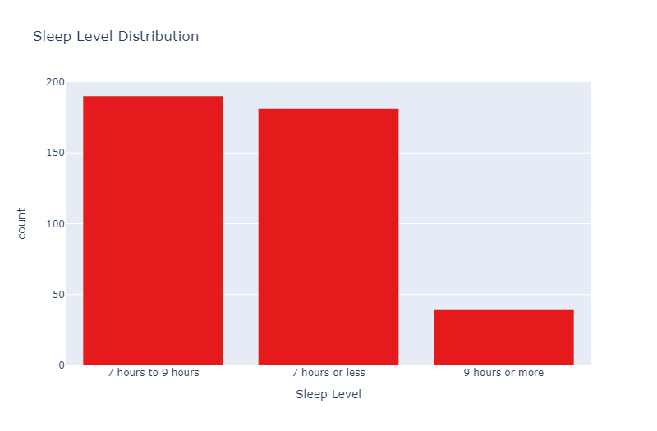
Sleeping hours were mostly less than 9 hours, more than half of them fall into 7 to 9 hours of sleep

Slide 23
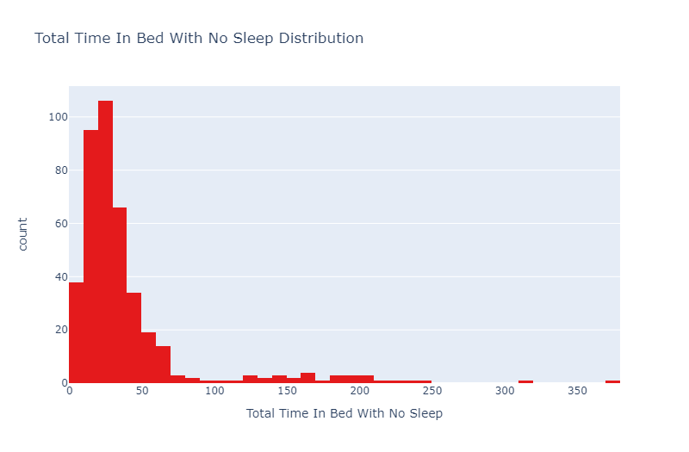
Users tend to stay in bed before getting into sleep mostly for less than 70 minutes, with a mean of 39.3 minutes

Slide 24
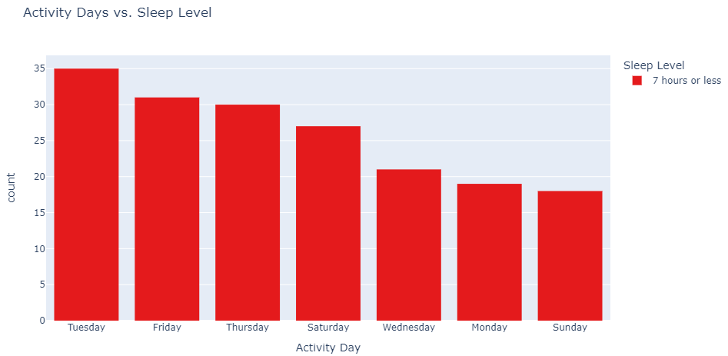
Users tend to sleep the least amount of hours on Tuesdays, followed by Fridays and Thursdays

Slide 25
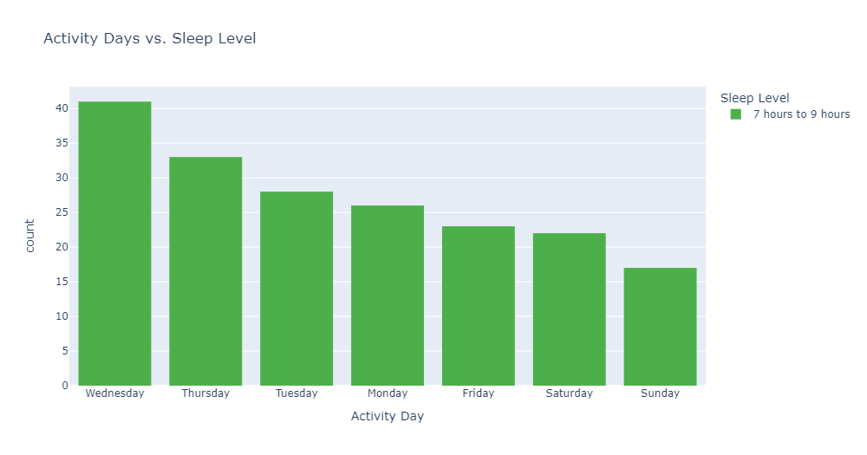
Wednesdays are more comfortable in the amount of hours slept, and takes the first spot for sleep levels of 7 to 9 hours

Slide 26
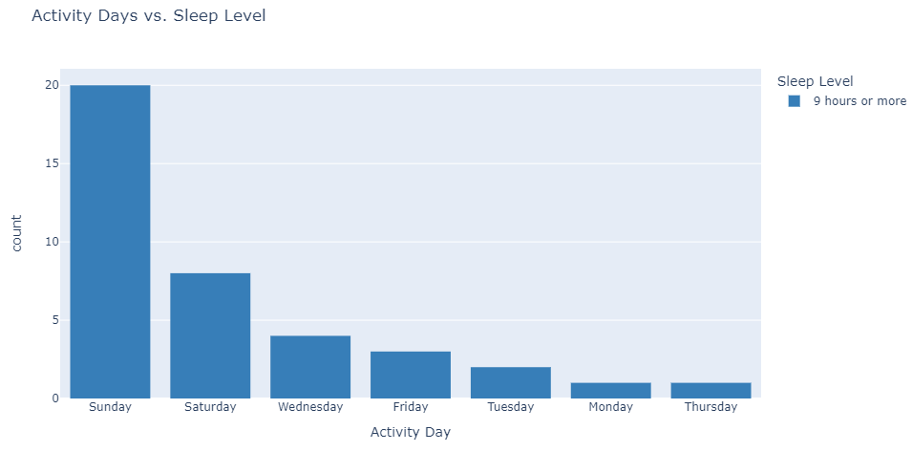
Users tend to sleep more than 9 hours on the weekends, as Sundays take the lead, followed by Saturdays

Slide 27
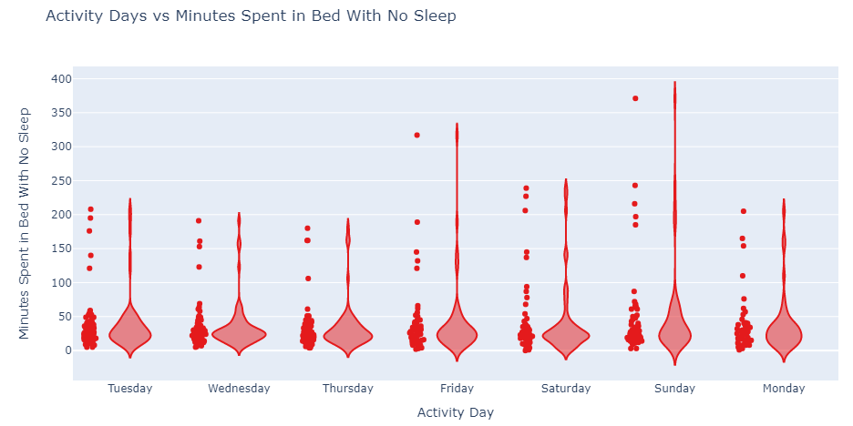
I can see a pattern of more minutes spent in bed with no sleep on the weekends (more insomnia on the weekends)

Slide 28
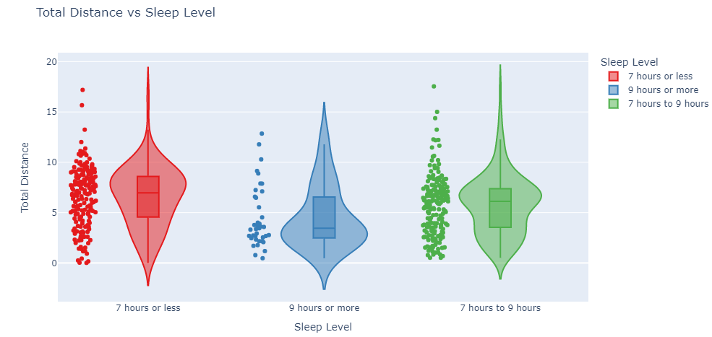
I Here I can see a negative relationship between Total Distance and Sleep Level, as Sleep Levels (durations of sleep) decrease when the Total Distances increase, this is merely a correlation and doesn't imply causation

Slide 29
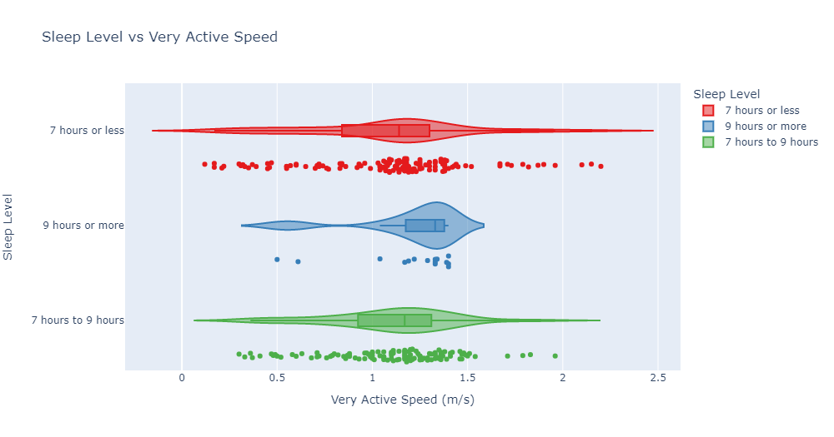
I can see an overall pattern of increased very active speed values when sleep levels are 9 hours of sleep or more (median in 9 hours or more of sleep is 1.33 m/s compared to 1.14 m/s in 7 hours or less, and 1.17 m/s in 7 to 9 hours)

Slide 30
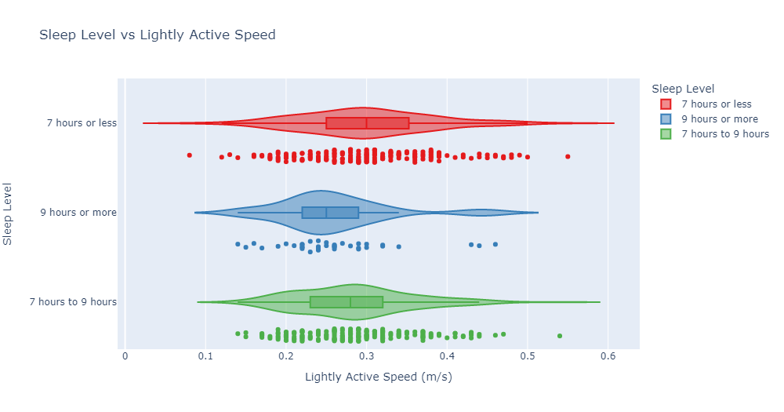
There seems to be an overall pattern of increased lightly active speed values when sleep levels are 7 hours of sleep or less (median in 7 hours or less of sleep is 0.3 m/s compared to 0.28 m/s in 7 to 9 hours, and 0.25 m/s in 9 hours or more)

Slide 31
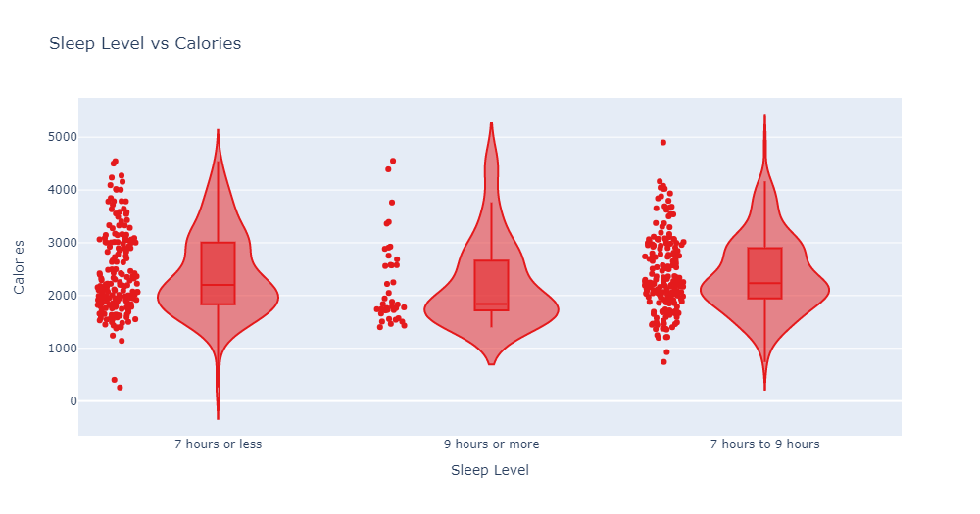
Mostly when calories burnt in a day are above the 2000 calories mark, users tend to sleep less than 9 hours, whereas when the calories burnt in a day decreases, especially under 2000 calories, users tend to sleep more than 9 hours

Slide 32
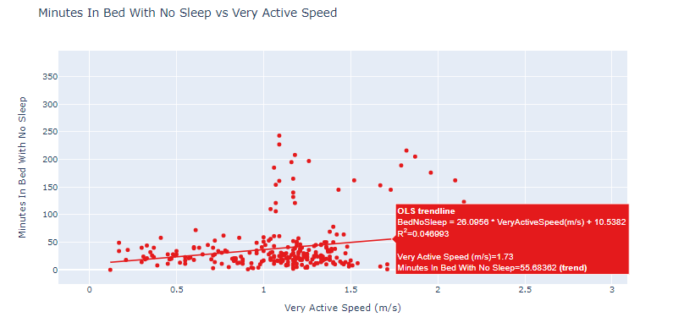
I can see that there's a very weak correlation between increasing very active speed values and the number of minutes spent in bed with no sleep (R-Squared=0.047), I don't think there's a definite causation between these two variables, but maybe If these very active running speed values have happened close to bedtime, they might induce insomnia

Slide 33
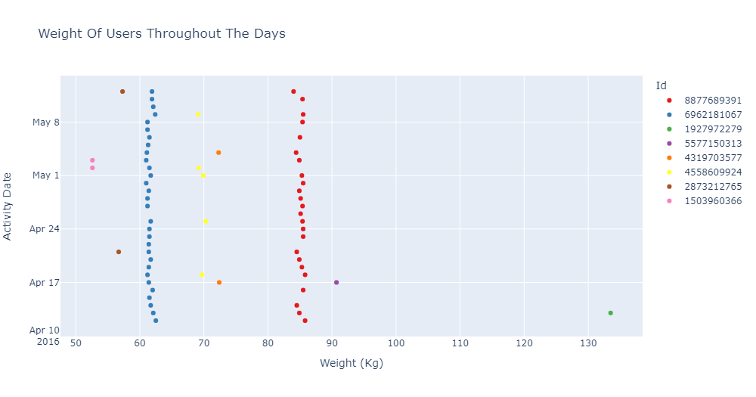
The interval is very short to see a great variation in weights, in addition to the fact that most users don't even register their weights periodically (only 8 users were tracking their weight progress, and not even periodically)

Slide 34
RECOMMENDATIONS
AND NEXT STEPS

Slide 35
RECOMMENDATIONS
AND NEXT STEPS
1
Users could receive a weekly report of daily total walked distances, total burnt calories against the goals set in some form of a progress bar or a percentage, of daily average speed values, and a percentage of the variation between the averages from every week to its previous

Slide 36
RECOMMENDATIONS
AND NEXT STEPS
2
As sedentary minutes make 81.3% of the users total daily minutes, Bellabeat can send a regular notification to the user when in sedentary mode informing them when they've been setting down for too long and encouraging them to take a walk.

Slide 37
RECOMMENDATIONS
AND NEXT STEPS
3
Bellabeat could introduce competitions between different users with similar body features, which would highly encourage lots of users to do more in order to beat those who are similar to them.

Slide 38
RECOMMENDATIONS
AND NEXT STEPS
4
Users to receive warnings when running very fast close to bedtime stating that it might induce insomnia and less sleeping quality.

Slide 39
RECOMMENDATIONS
AND NEXT STEPS
5
As most users have not tracked their weight progress, Bellabeat could promote persistent weight tracking features to users to hook them and even get new users.

Slide 40
THANK YOU!
Q & A

